Slide 1
MCA
Data set: IBM-NoAttritionDataset
Richa
2018.10.13

Slide 2
Introduction
Data: IBM-HR-Employee-NoAttrition
Rows: The 1233 observations describe the Employees of IBM.
Columns: 32 variables
Sub, Age, BusinessTravel,Department, Monthly Income, Daily Rate, Hourly Rate, MonthlyRate, DistanceFromHome, PerformanceRating, Education, JobInvolvement, Job level, StockOptionLevel, PercentSalaryHike, TotalWorkingYears, TrainingTimesLastYear, WorkLifeBalance, WorkLifeBalance, YearsAtCompany, YearsInCurrentRole, YearsSinceLastPromotion, Years With CurrManager, EnvironmentSatisfaction, JobSatisfaction, RelationshipSatisfaction, Attrition,Field, Gender, JobRole, MaritalStatus and OverTime.
Research Question
How do all 1233 employees differ on the variables like Gender type vs Department ? Job level vs MonthlyIncome ? etc.

Slide 3
Subj Age Attrition BusinessTravel Department EducationField Gender JobRole
1 2 49 No Travel_Frequently Research & Development Life Sciences Male Research Scientist
2 4 33 No Travel_Frequently Research & Development Life Sciences Female Research Scientist
3 5 27 No Travel_Rarely Research & Development Medical Male Laboratory Technician
4 6 32 No Travel_Frequently Research & Development Life Sciences Male Laboratory Technician
5 7 59 No Travel_Rarely Research & Development Medical Female Laboratory Technician
6 8 30 No Travel_Rarely Research & Development Life Sciences Male Laboratory Technician
MaritalStatus OverTime MonthlyIncome DailyRate HourlyRate MonthlyRate DistanceFromHome PerformanceRating
1 Married No 5130 279 61 24907 8 4
2 Married Yes 2909 1392 56 23159 3 3
3 Married No 3468 591 40 16632 2 3
4 Single No 3068 1005 79 11864 2 3
5 Married Yes 2670 1324 81 9964 3 4
6 Divorced No 2693 1358 67 13335 24 4
Education JobInvolvement JobLevel StockOptionLevel NumCompaniesWorked PercentSalaryHike TotalWorkingYears
1 1 2 2 1 1 23 10
2 4 3 1 0 1 11 8
3 1 3 1 1 9 12 6
4 2 3 1 0 0 13 8
5 3 4 1 3 4 20 12
6 1 3 1 1 1 22 1
TrainingTimesLastYear WorkLifeBalance YearsAtCompany YearsInCurrentRole YearsSinceLastPromotion
1 3 3 10 7 1
2 3 3 8 7 3
3 3 3 2 2 2
4 2 2 7 7 3
5 3 2 1 0 0
6 2 3 1 0 0
YearsWithCurrManager EnvironmentSatisfaction JobSatisfaction RelationshipSatisfaction
1 7 3 2 4
2 0 4 3 3
3 2 1 2 4
4 6 4 4 3
5 0 3 1 1
6 0 4 3 2

Slide 4
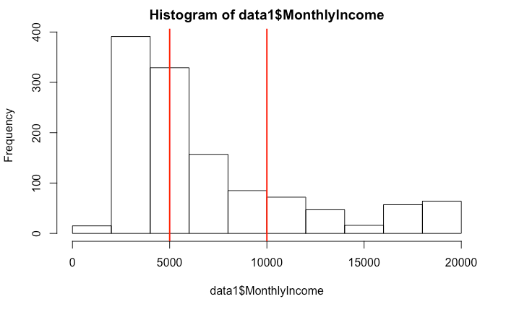
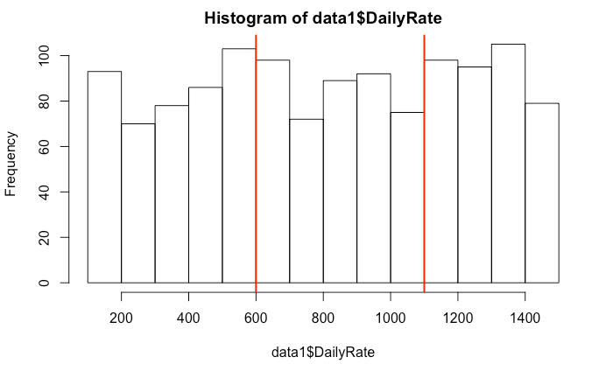
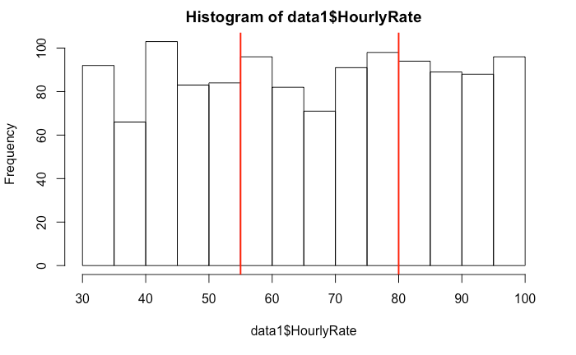
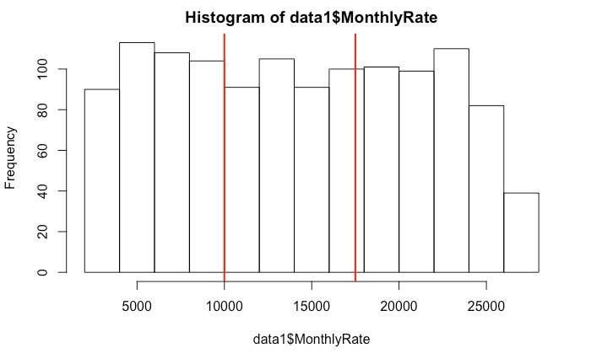
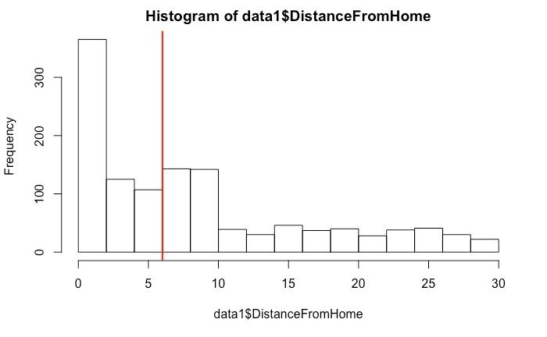
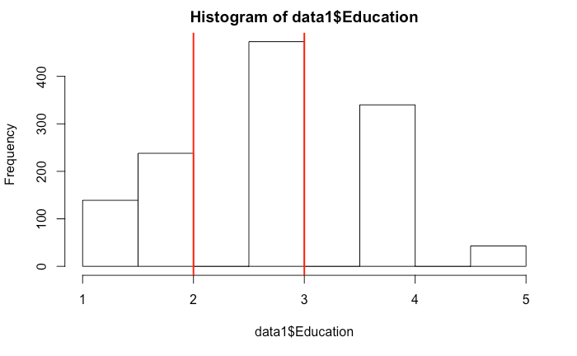
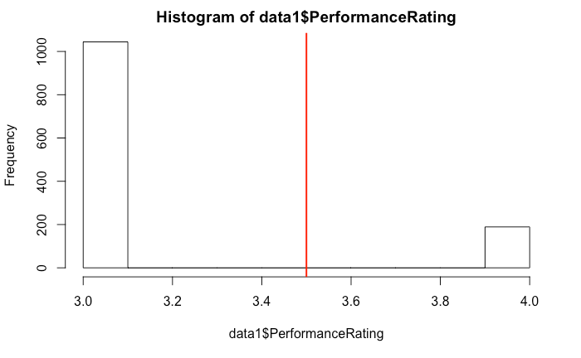
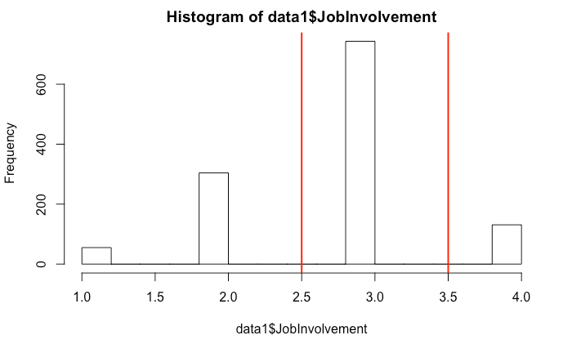
Distribution of Data

Slide 5
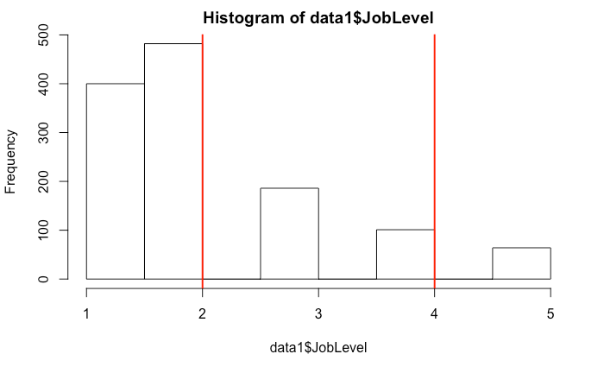
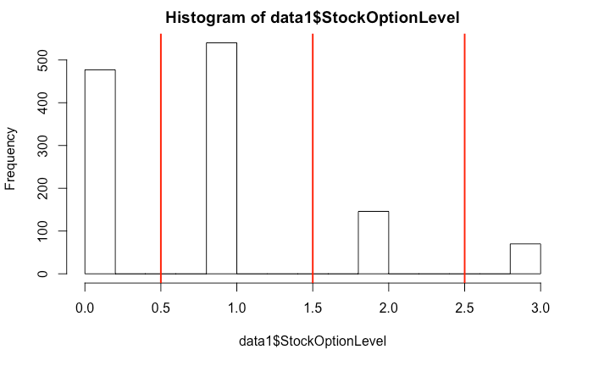
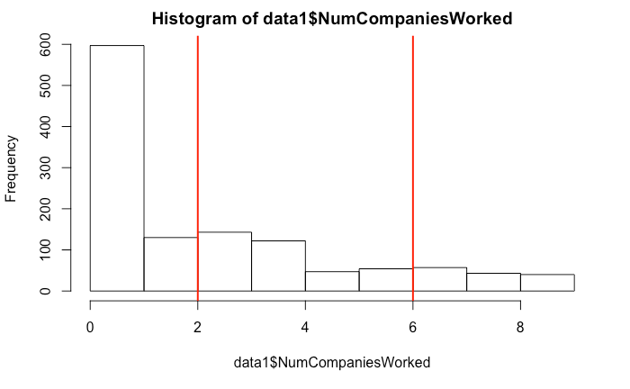
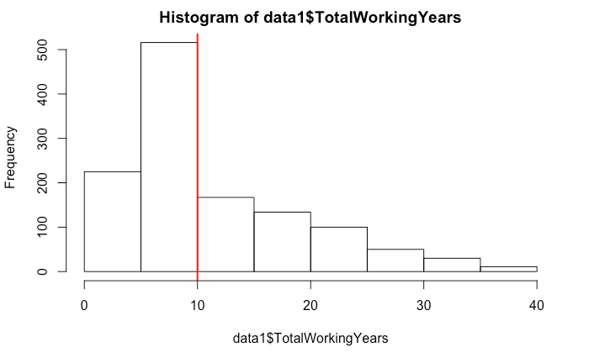
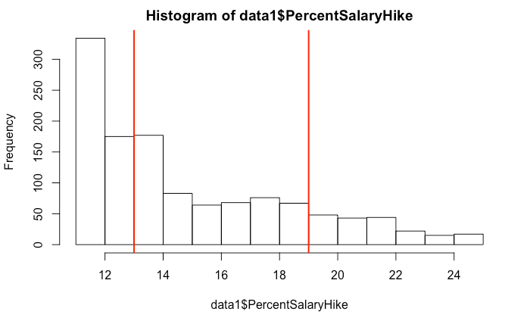
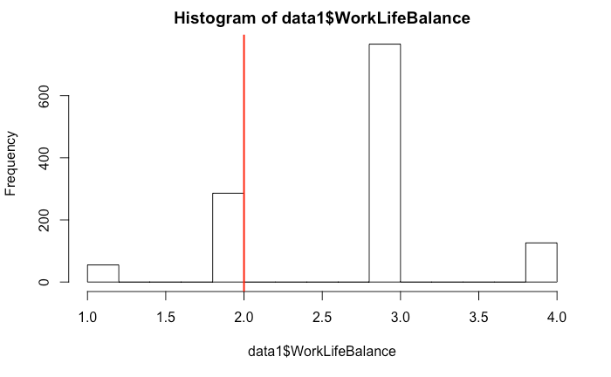
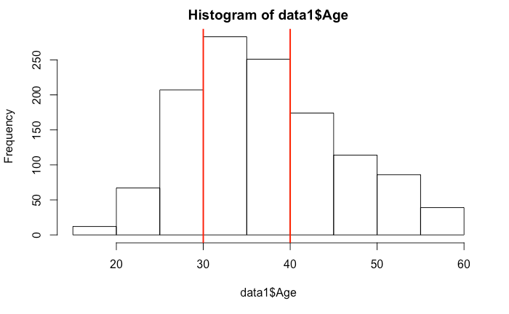
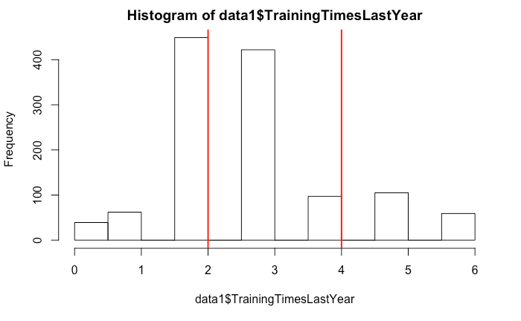
Distribution of Data

Slide 6
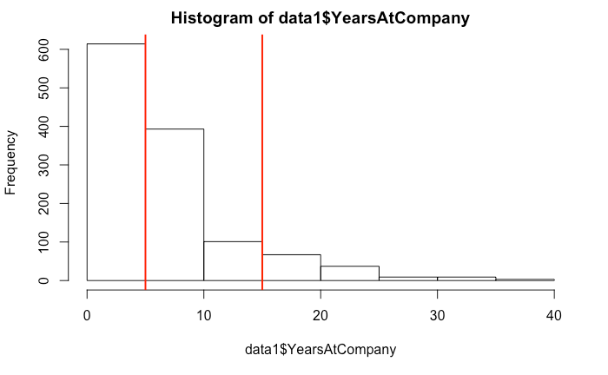
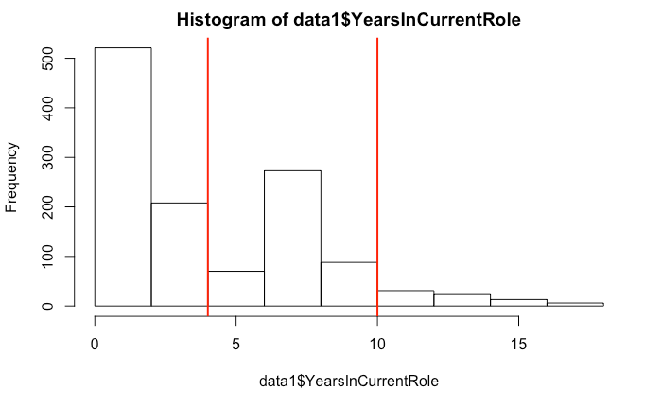
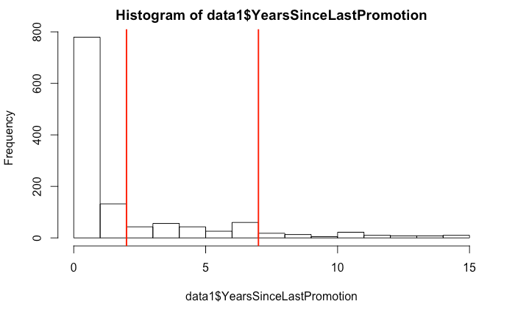
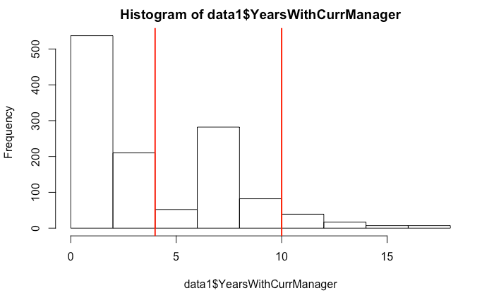
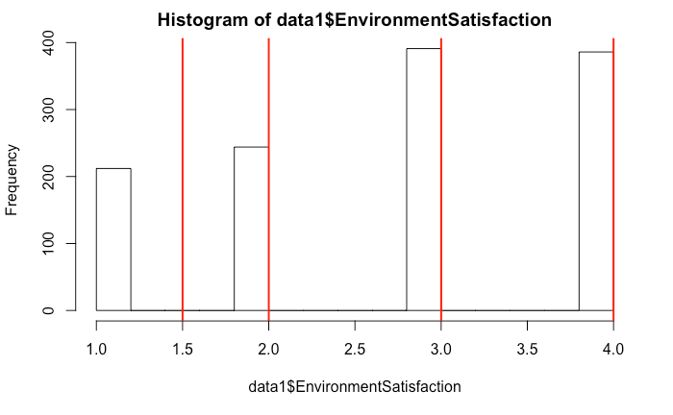
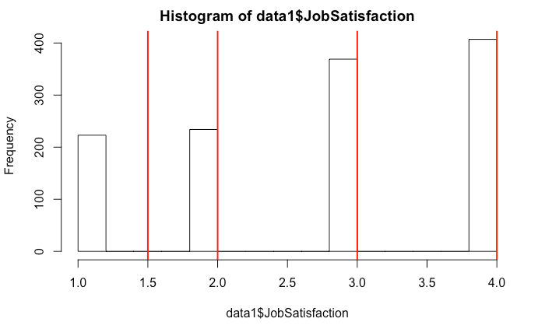
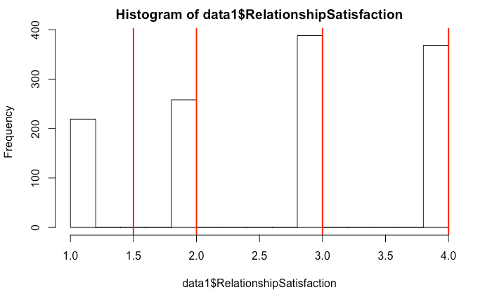
Distribution of Data

Slide 7
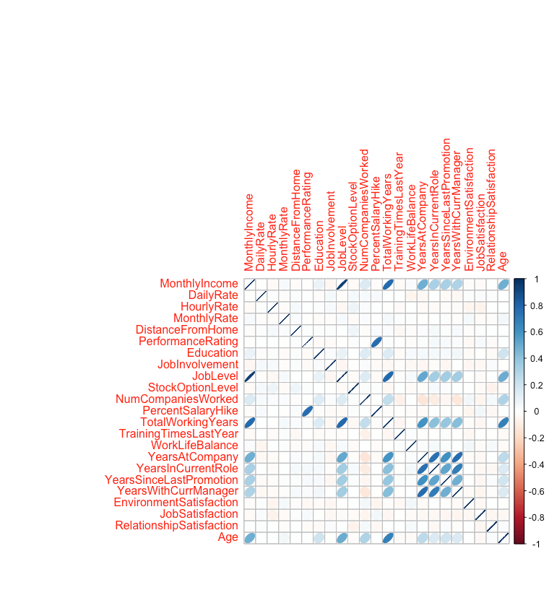
Correlation

Slide 8
HeatMap(Burt Table)

Slide 9
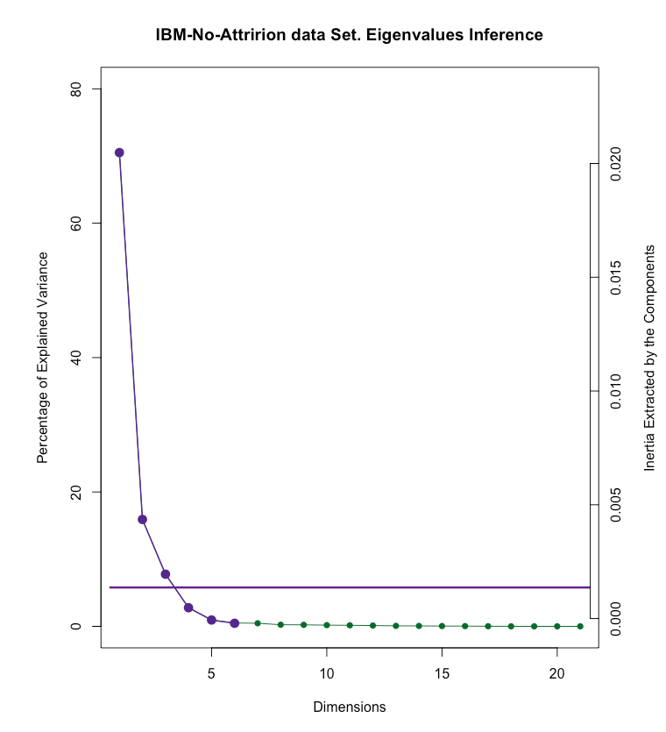
Scree plot

Slide 10
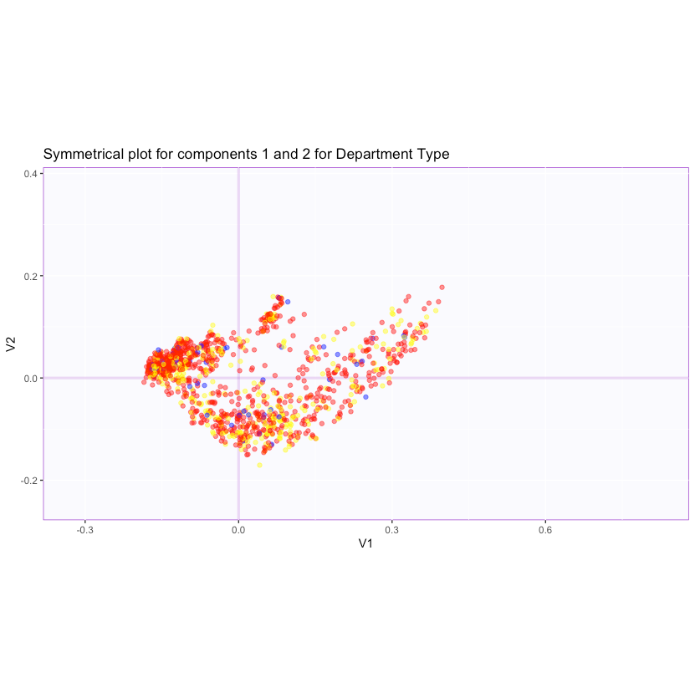
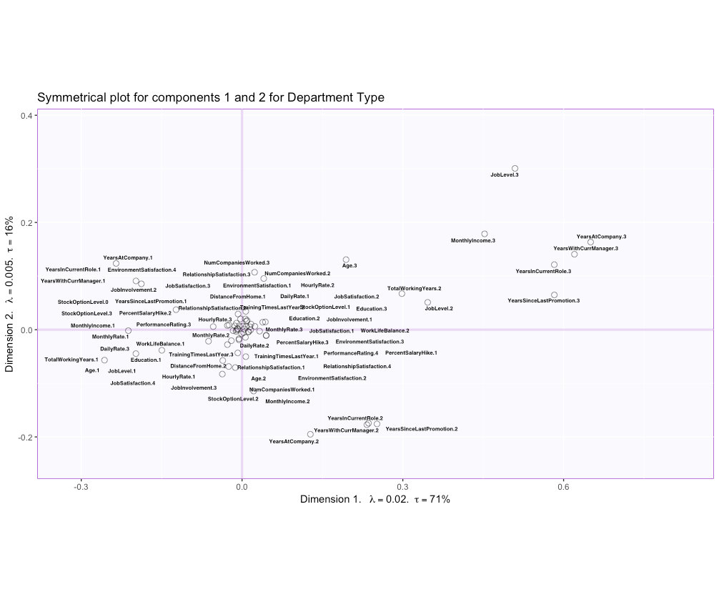
Biplot

Slide 11
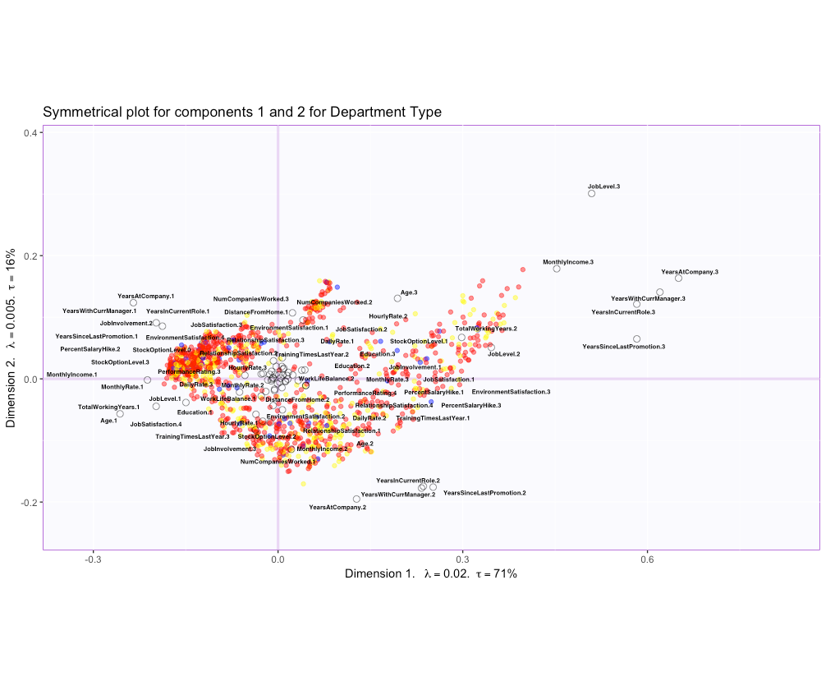
Biplot

Slide 12
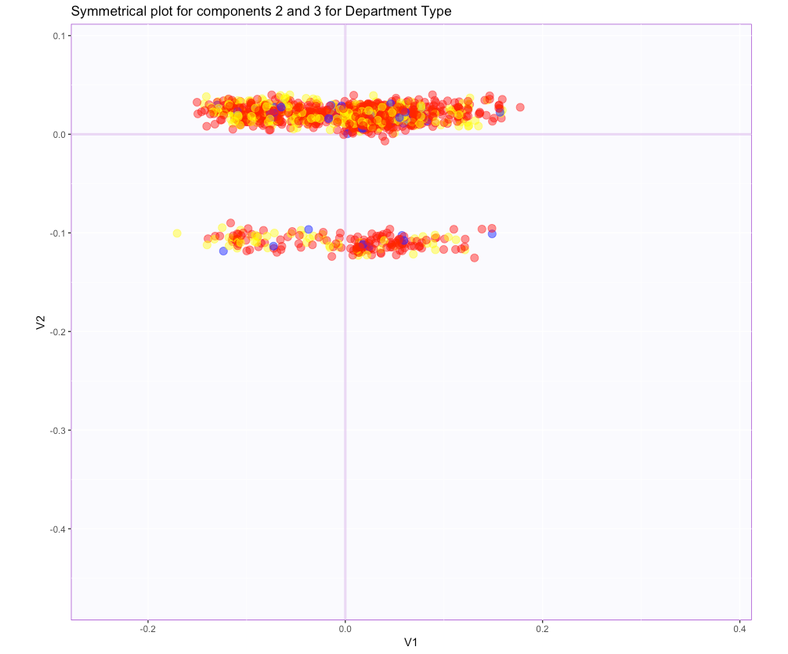
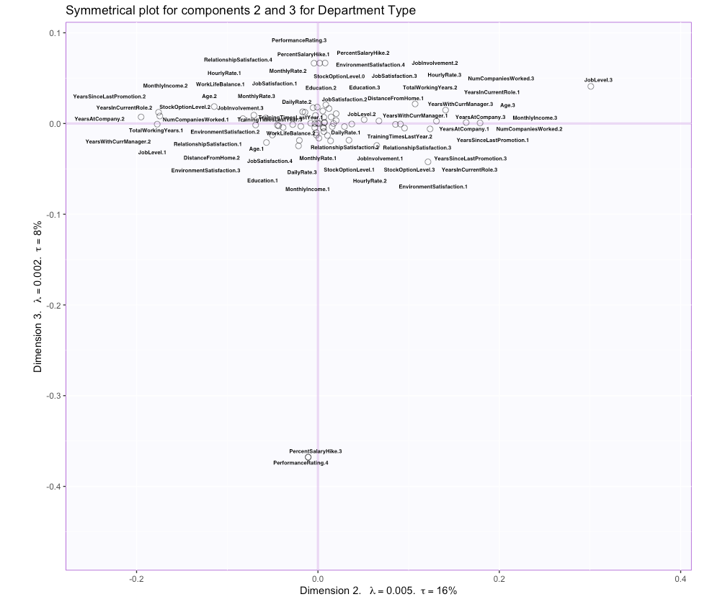
Biplot

Slide 13
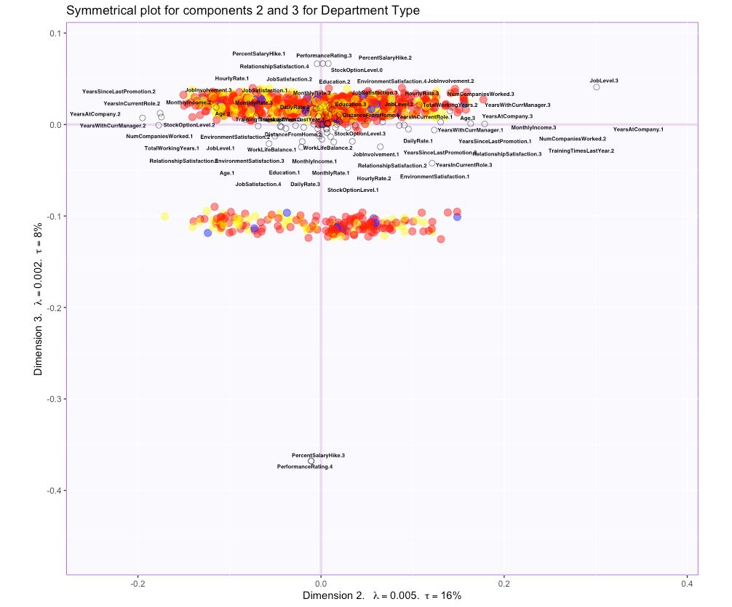
Biplot

Slide 14
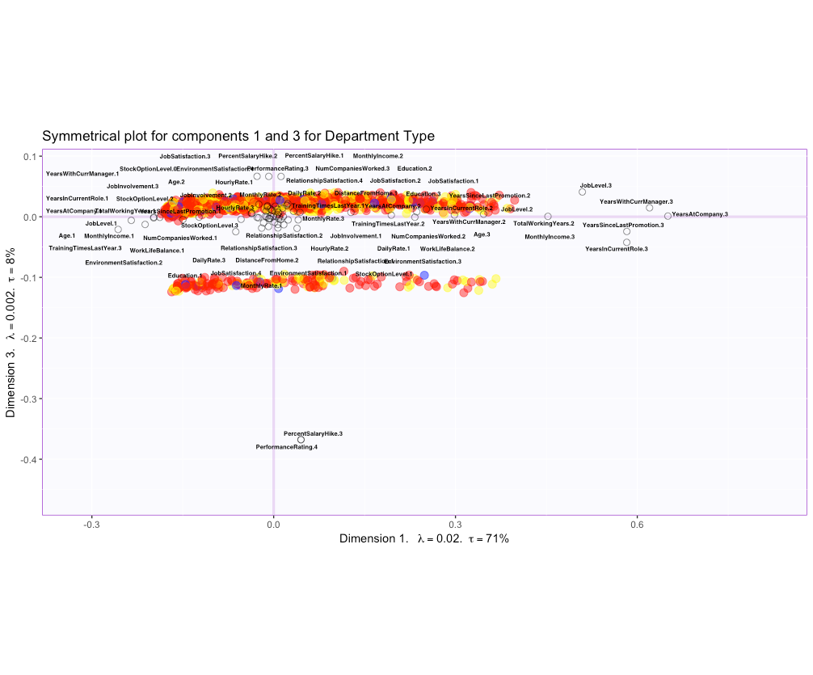
Biplot

Slide 15
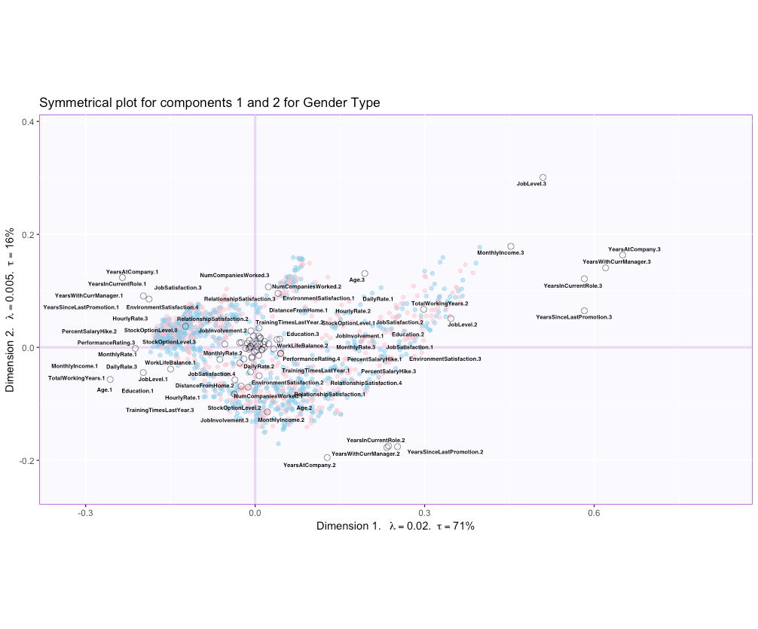
Biplot

Slide 16
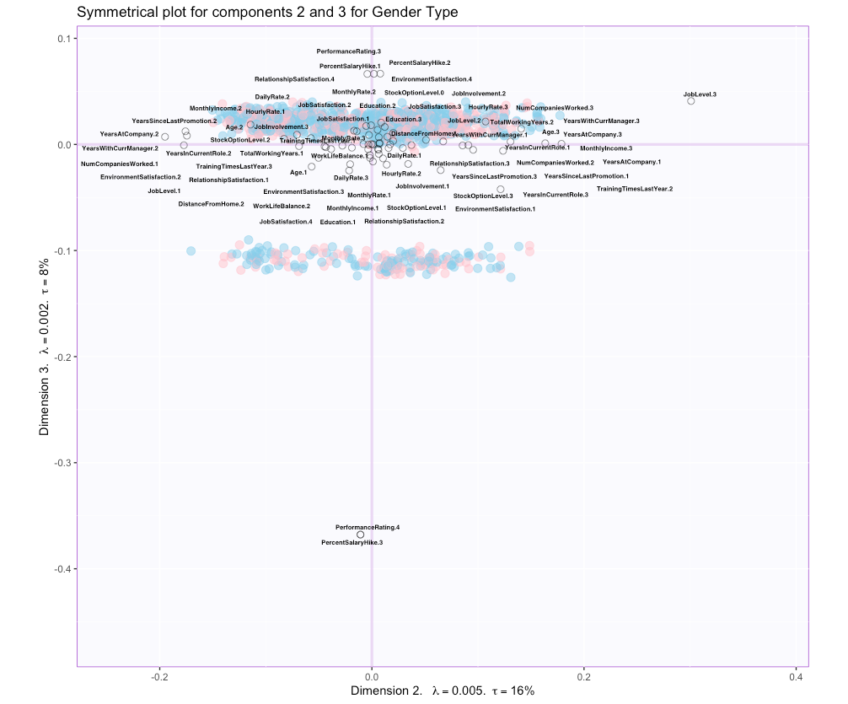
Biplot

Slide 17
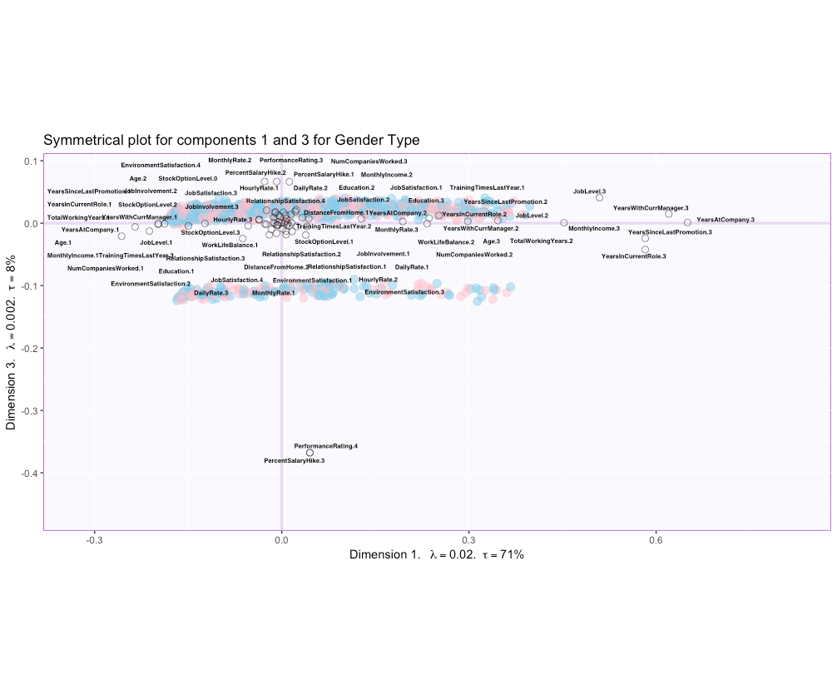
Biplot

Slide 18
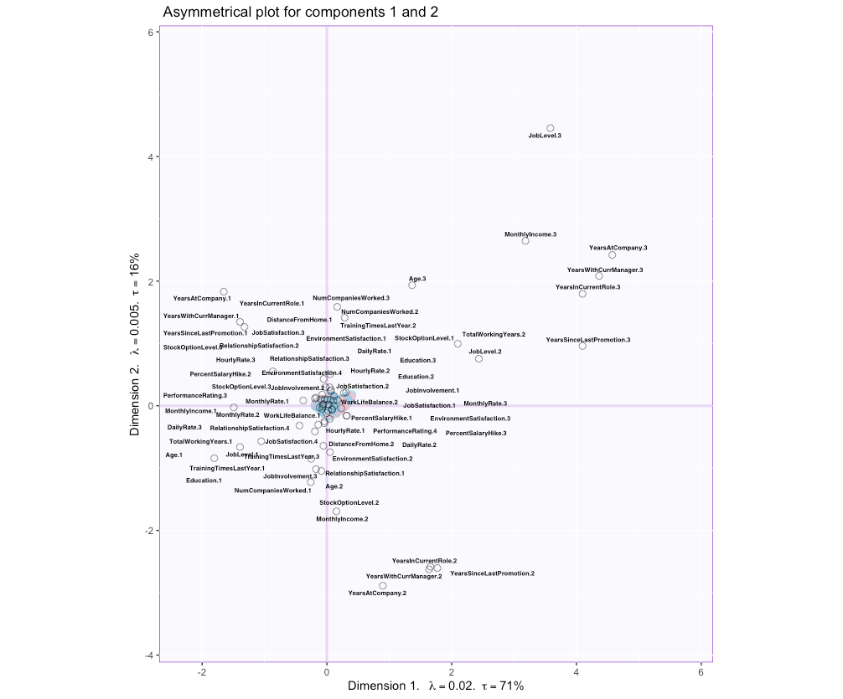
Biplot

Slide 19
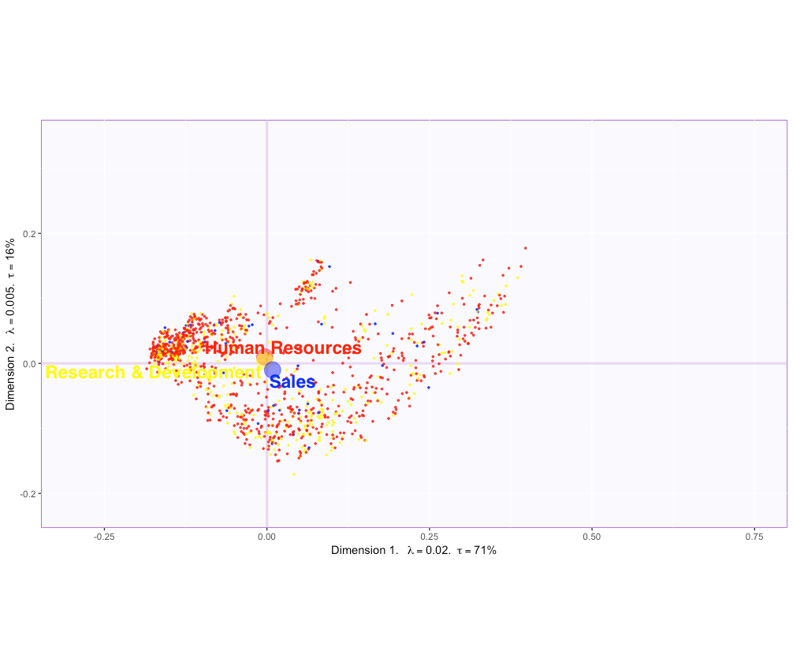
Bootstrap Interval

Slide 20

Bootstrap Interval

Slide 21
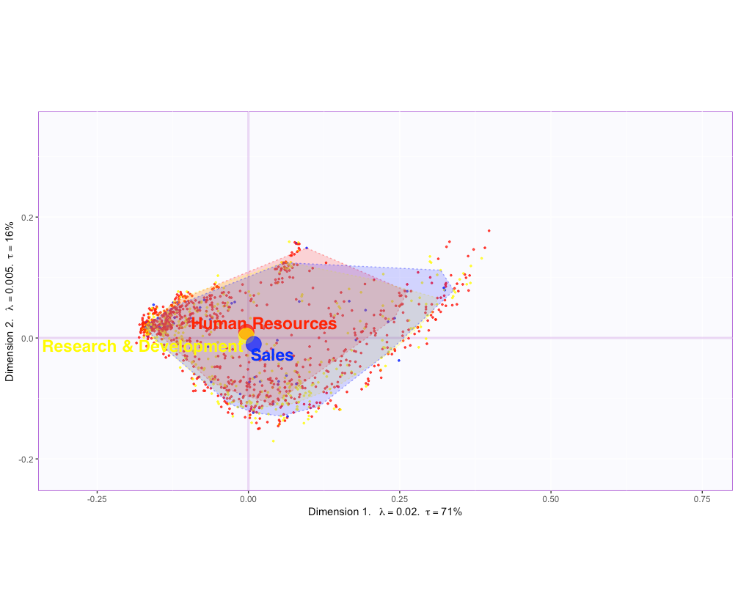
ConvexHull

Slide 22
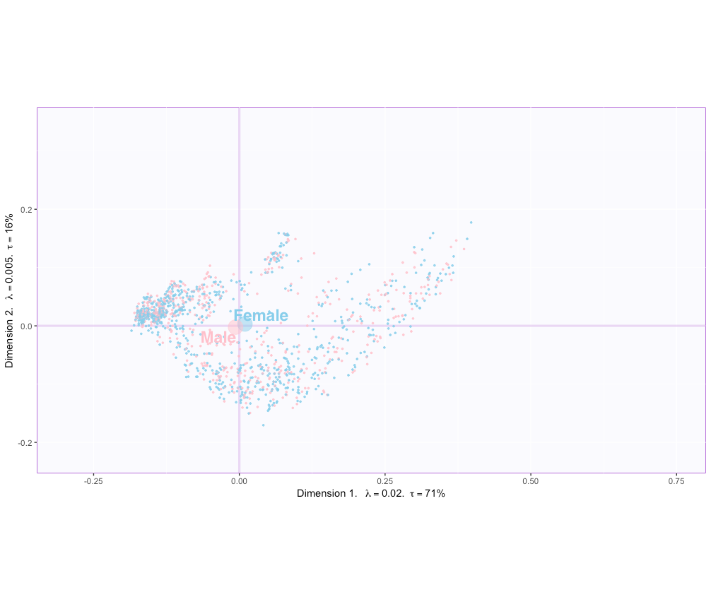
Bootstrap Interval

Slide 23

Bootstrap Interval

Slide 24
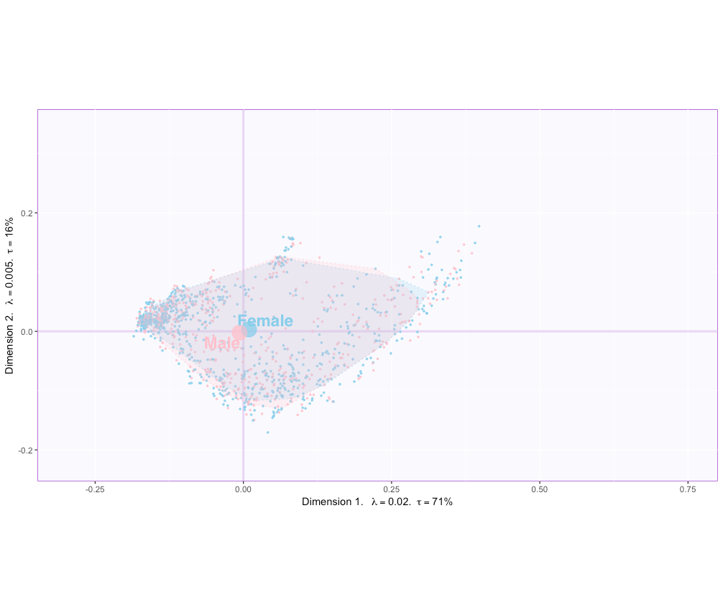
ConvexHull

Slide 25
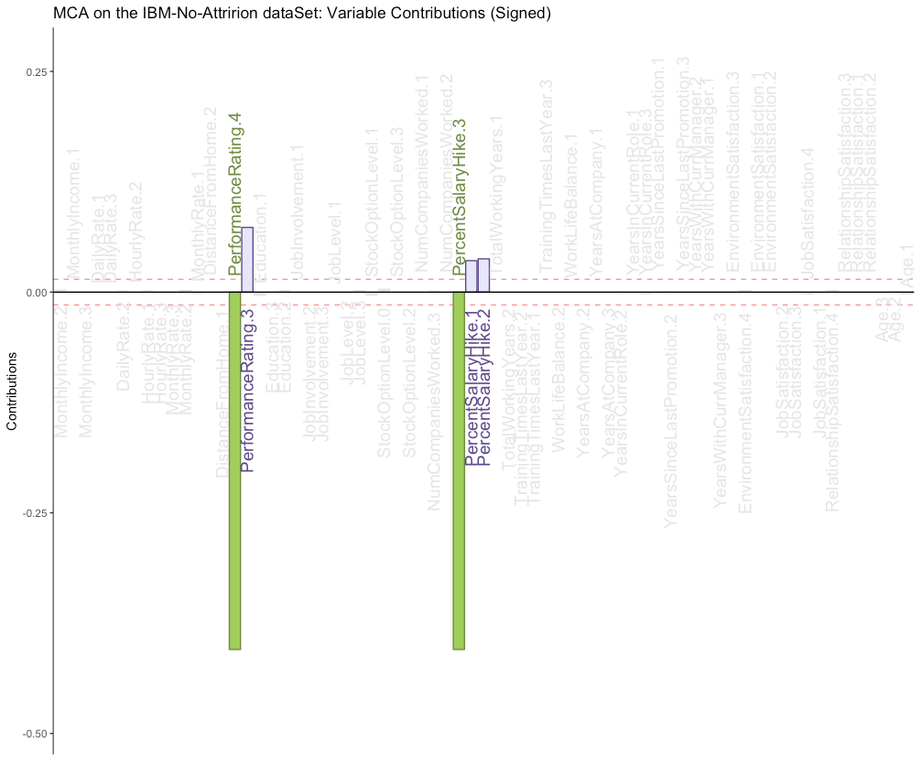
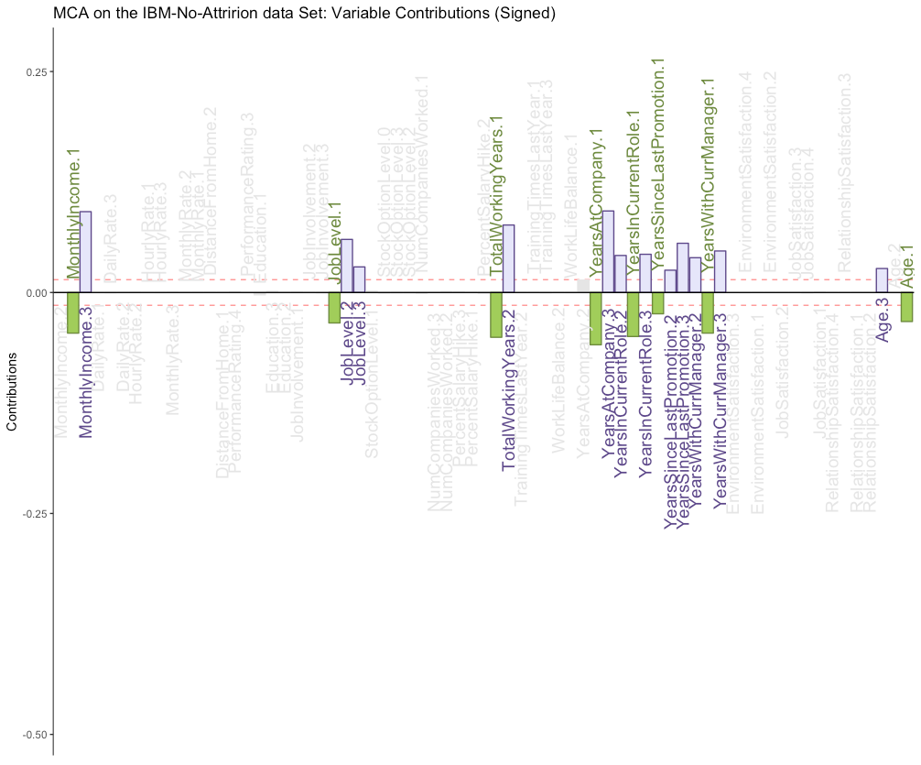
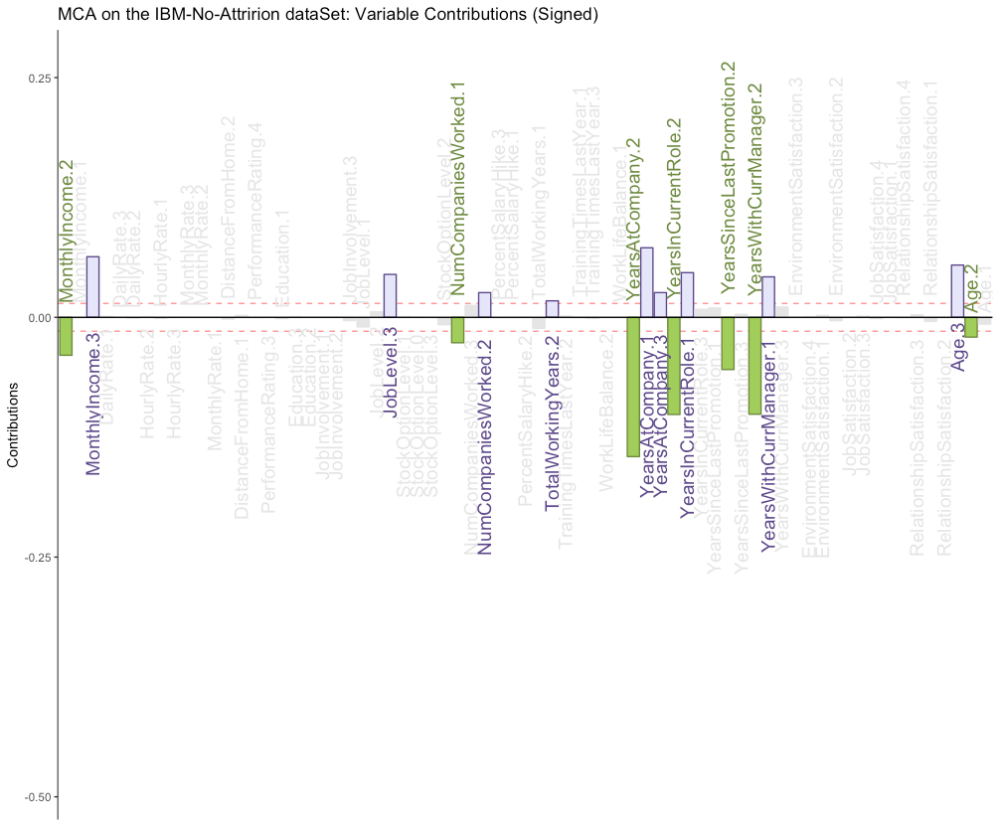
Contributions

Slide 26
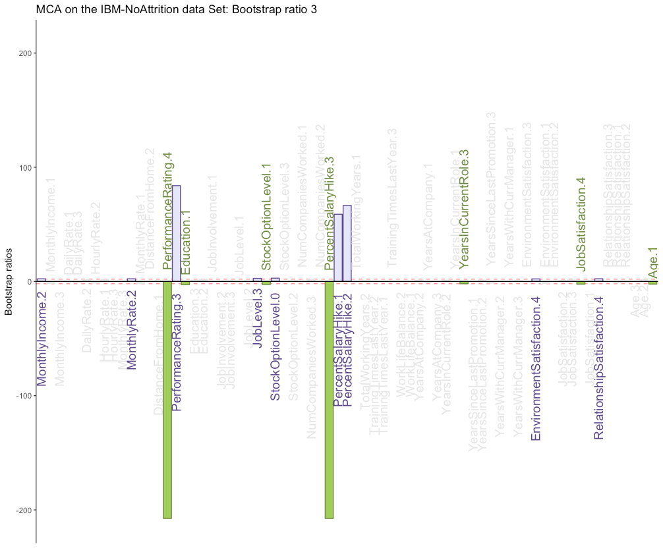
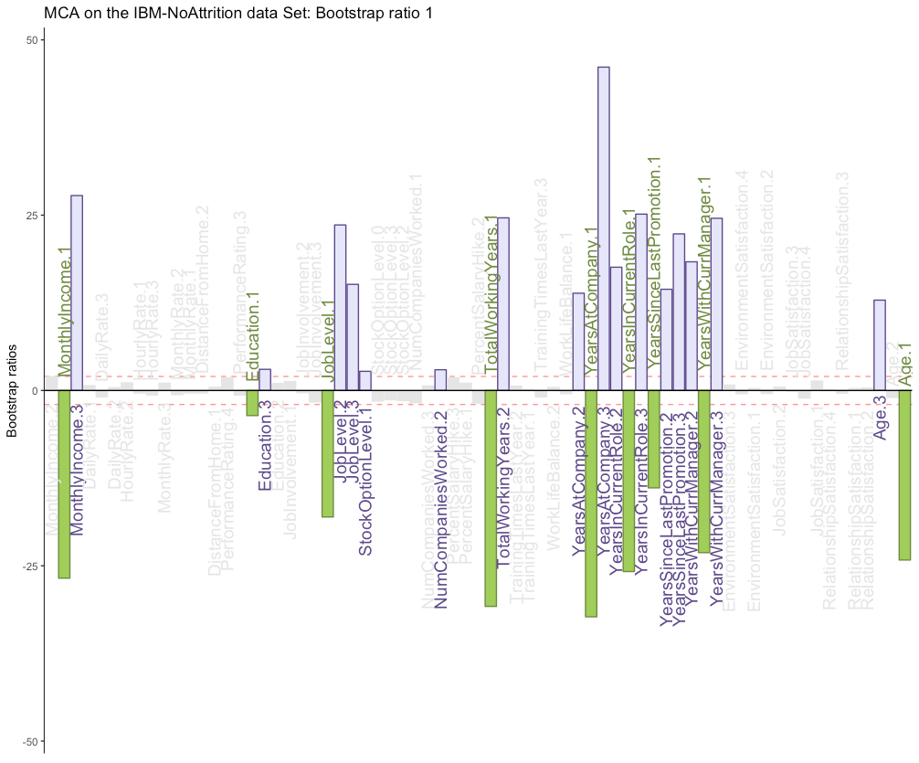
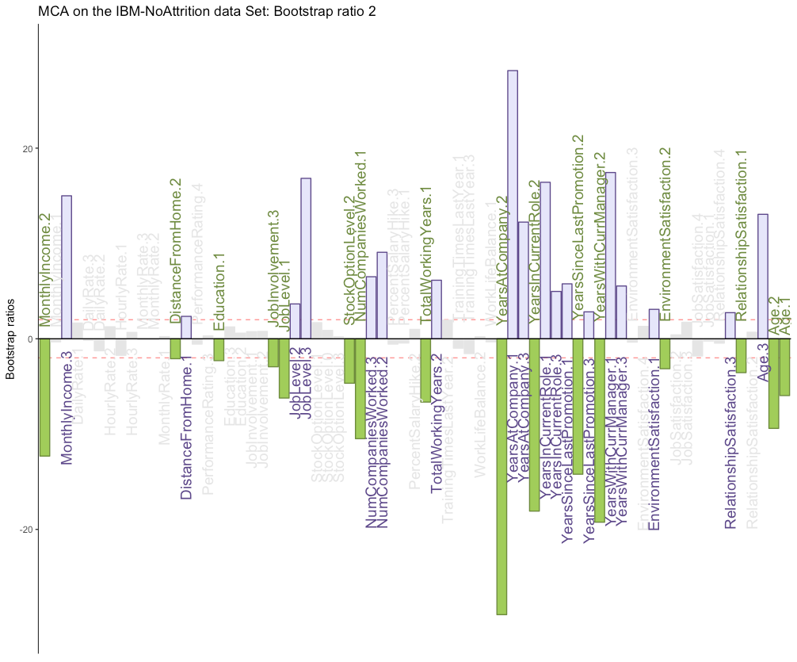
Bootstrap Ratios

Slide 27
Conclusion
Component 1
Department Biplot : People from HR and RD generally earn in the range of 5k to 10k monthly
Gender Biplot :
Interpret:
Component 2
Department Biplot :
Gender Biplot :
Interpret:
Component 3
Department Biplot :
Gender Biplot :
Interpret:

Slide 28
Questions or comments?

